Slide 1

HTML
Lesson 4

Slide 2
HTML – Tables
HTML Table Tags
Tag | Description
<table> | Defines a table
<th> | Defines a header cell in a table
<tr> | Defines a row in a table
<td> | Defines a cell in a table
<caption> | Defines a table caption
<colgroup> | Specifies a group of one or more columns in a table for formatting
<col> | Specifies column properties for each column within a <colgroup> element
<thead> | Groups the header content in a table
<tbody> | Groups the body content in a table
<tfoot> | Groups the footer content in a table

Slide 3
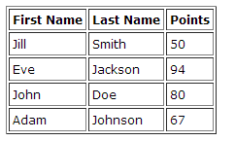
HTML – Tables
Tables are defined with the <table> tag.
A table is divided into rows -<tr> tag
Each row is divided into data cells -<td> tag

Slide 4

HTML – Tables
<table border="1">
<tr>
<td>row 1, cell 1</td>
<td>row 1, cell 2</td>
</tr>
<tr>
<td>row 2, cell 1</td>
<td>row 2, cell 2</td>
</tr>
</table>
To display a table with borders, specify the border attribute.

Slide 5

HTML – Tables
Table Headers:
<table border="1">
<tr>
<th>Header 1</th>
<th>Header 2</th>
</tr>
<tr>
<td>row 1, cell 1</td>
<td>row 1, cell 2</td>
</tr>
<tr>
<td>row 2, cell 1</td>
<td>row 2, cell 2</td>
</tr>
</table>
Header information in a table are defined with the <th> tag.

Slide 6
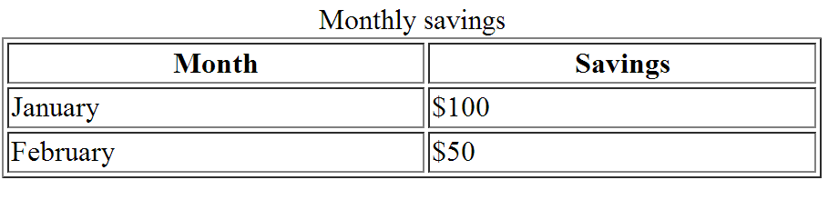
HTML – Tables
Table Captions:
<table border="1" width="450">
<caption>Monthly savings</caption>
<tr>
<th>Month</th>
<th> Savings </th>
</tr>
<tr>
<td> January</td>
<td> $100</td>
</tr>
<tr>
<td> February</td>
<td> $50</td>
</tr>
</table>

Slide 7
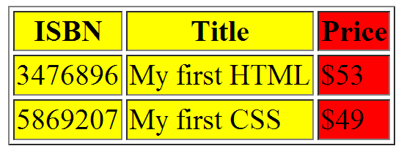
HTML – Tables
<table>
<colgroup>
<col span="2" bgcolor="yellow">
<col bgcolor="red">
</colgroup>

Slide 8
HTML – Tables
Thead Tbody Tfoot:
<table border="1">
<thead>
<tr>
<th>Month</th><th>Savings</th>
</tr>
</thead>
<tfoot>
<tr>
<td>Sum</td><td>$180</td>
</tr>
</tfoot>
<tbody>
<tr>
<td>January</td> <td>$100</td>
</tr>
<tr>
<td>February</td><td>$80</td>
</tr>
</tbody>
</table>
<head>
<style type="text/css">
thead {color:green;}
tbody {color:blue;}
tfoot {color:red;}
</style>
</head>

Slide 9
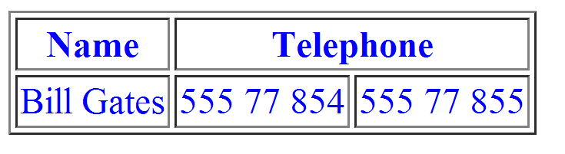
HTML – Tables
Table Colspan :
<table border="1">
<tr>
<th>Name</th>
<th colspan="2">Telephone</th>
</tr>
<tr>
<td>Bill Gates</td>
<td>555 77 854</td>
<td>555 77 855</td>
</tr>
</table>

Slide 10
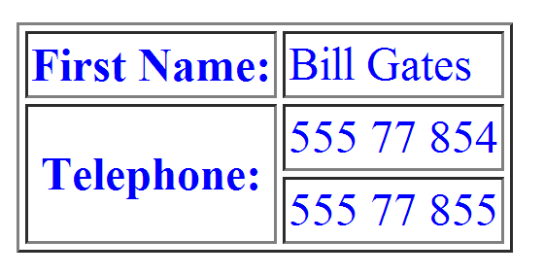
HTML – Tables
Table Rowspan :
<table border="1">
<tr>
<td> First Name</td>
<td>Bill Gates</td>
</tr>
<tr>
<td rowspan="2">Telephone</td>
<td>555 77 854</td>
</tr>
<tr>
<td>555 77 855</td>
</tr>
</table>

Slide 11
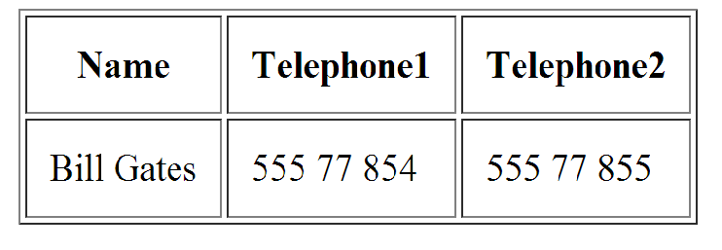
HTML – Tables
Table Cellpadding:
<table border="1" cellpadding="10">
<tr>
<th> Name</th>
<th> Telephone1</th>
<th> Telephone2</th>
</tr>
<tr>
<td>Bill Gates</td>
<td>555 77 854</td>
<td>555 77 855</td>
</tr>
</table>

Slide 12
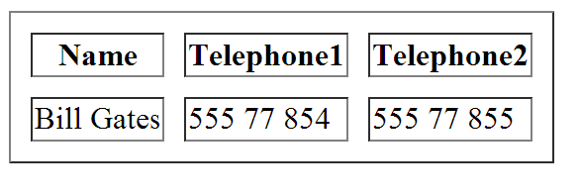
HTML – Tables
Table Cellspacing:
<table border="1" cellspacing="10">
<tr>
<th>Name</th>
<th Telephone1</th>
<th Telephone2</th>
</tr>
<tr>
<td>Bill Gates</td>
<td>555 77 854</td>
<td>555 77 855</td>
</tr>
</table>

Slide 13
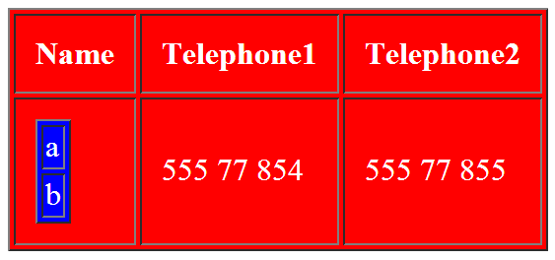
HTML – Tables
Table Inside Table:
<table border="1" cellpadding="10">
<tr>
<th>Name</th>
<th >Telephone1</th>
<th >Telephone2</th>
</tr>
<tr>
<td>
<table border="1">
<tr><td>a</td></tr>
<tr><td>b</td></tr>
</table>
</td>
<td>555 77 854</td>
<td>555 77 855</td>
</tr>
</table>

Slide 14
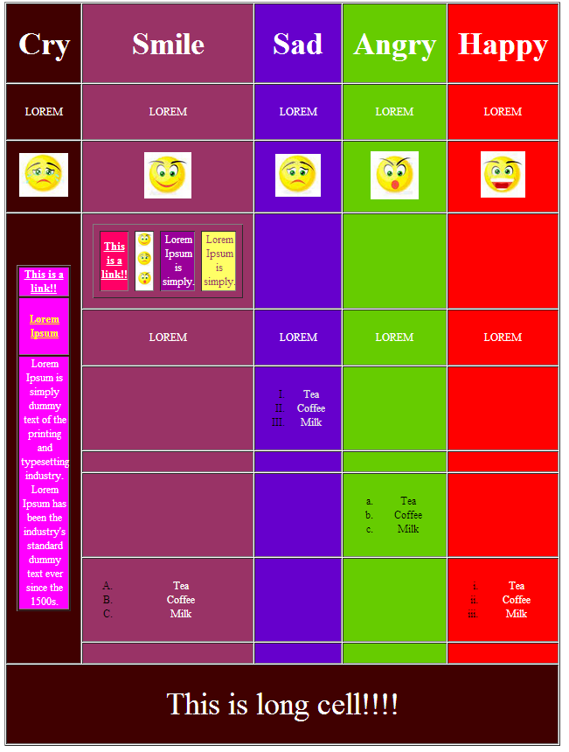
Task1:

Slide 15

Task2:

